Slide 1
Static Typing

Slide 2
Static Typing vs Dynamic Typing
When types are checked:
Static typing is checked before running the code
Dynamic typing is checked while running the code

Slide 3
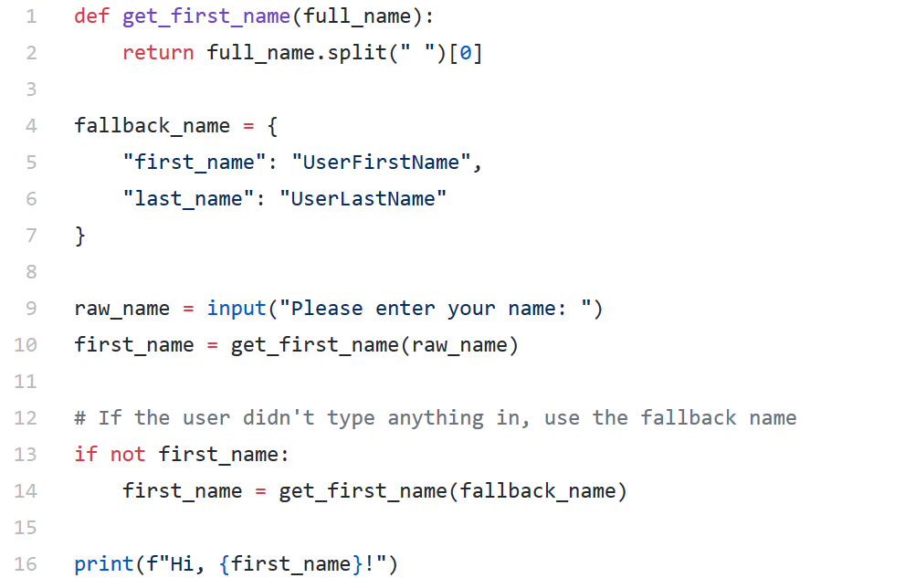

Slide 4
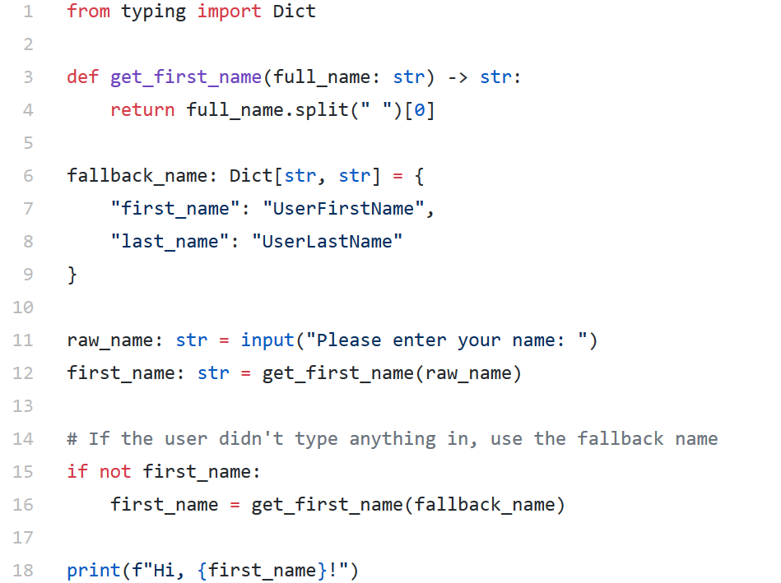

Slide 5
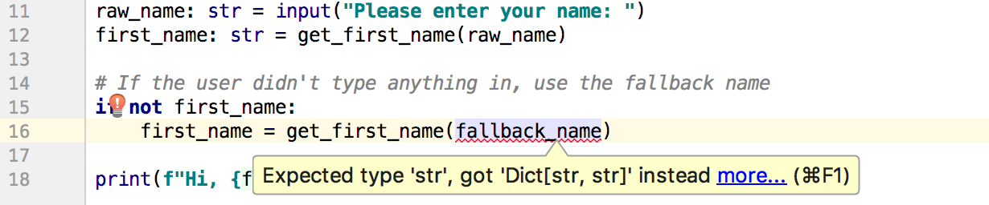

Slide 6
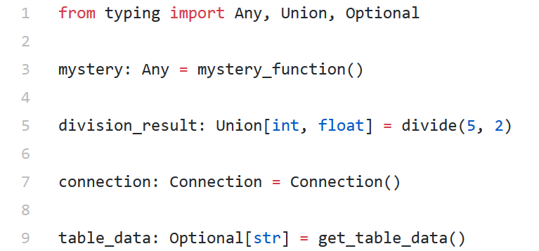
Types Examples

Slide 7
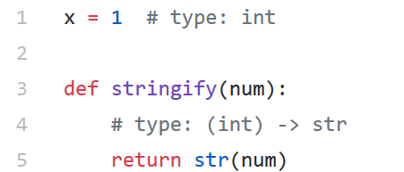
Python 2

